Slide 1

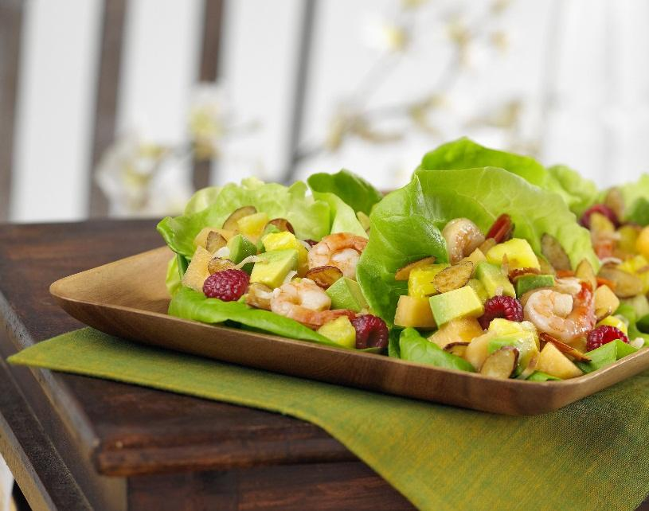
HealthDash
By: Jerry Chen, Prateek Chellani, and Vismaya Manchaiah

Slide 2
What is HealthDash?
HealthDash is a website that shows off campus, on campus, and delivery options for meals. It includes menus for the different dining halls on campus as well as nutritional facts. There are links that are provided for the different restaurants off campus and promotional deals. It has locations and hours for all the different dining options.

Slide 3
UX Design Lifecycle Stage 1: Understand Needs
We came up with interview questions that would help us understand what a user was looking for in our website
We interviewed a group of people to determine what to put into our design
Then we analyzed the data gathered and worked on creating our design
A work flow model and WAAD was created based off the information gathered

Slide 4
Interview Questions
How far away from campus do you live?
Which do you use more: on campus or off campus dining?
Would having easy access to dining hall menus change your answer to the previous question?
How important is a menu with calorie counts to you?
How important is a list of restaurants that accept Bearcat Cards to you?
How important is a place to order food for delivery to you?
If there was a website that could bring all of these things together, how often would you use it?
What are some suggestions for things to add/change to the website?
Any other comments?
What is your favorite restaurant around campus?
How do you usually pay for your meals?
Around what time approx do you get food?

Slide 5
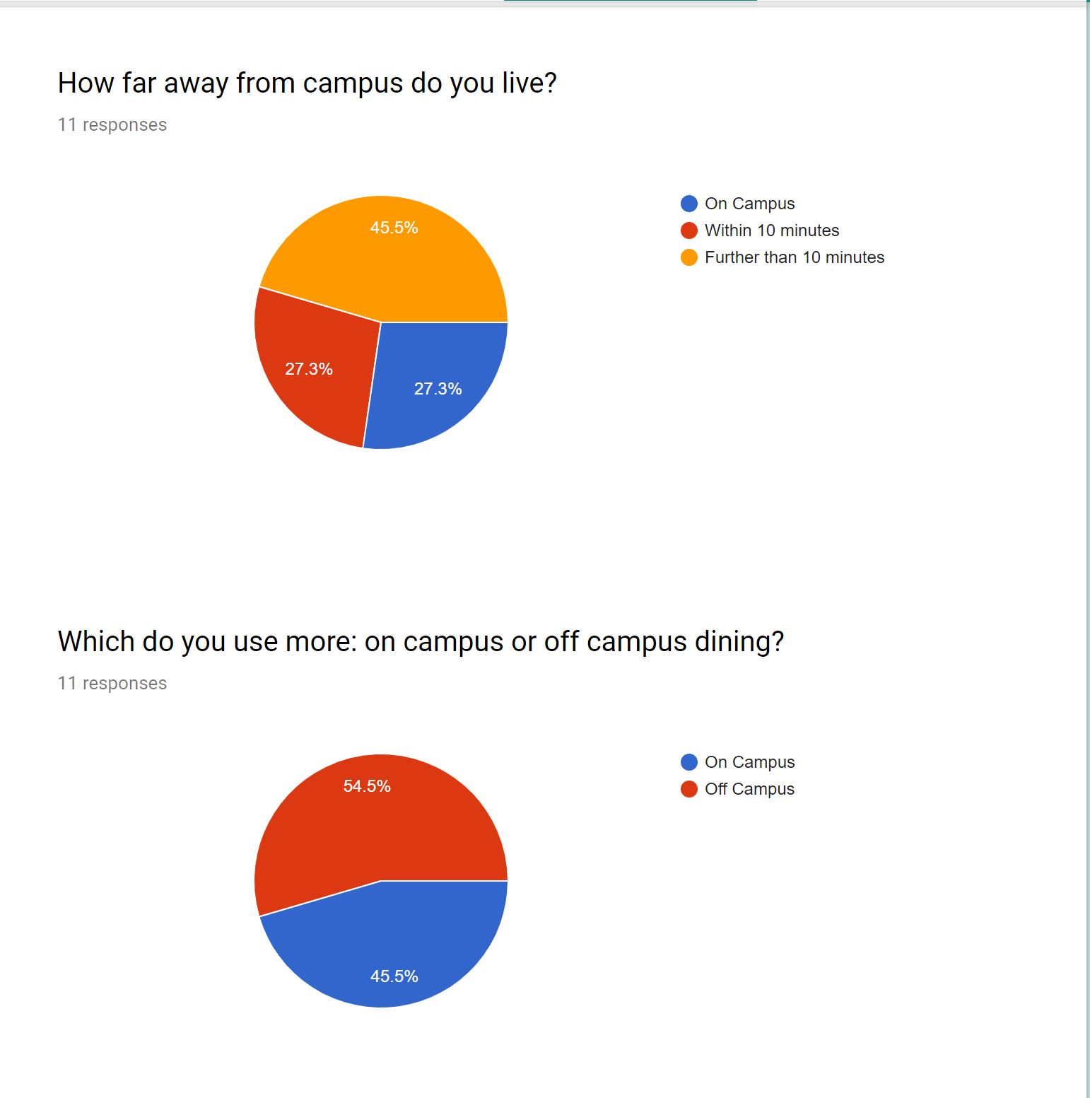
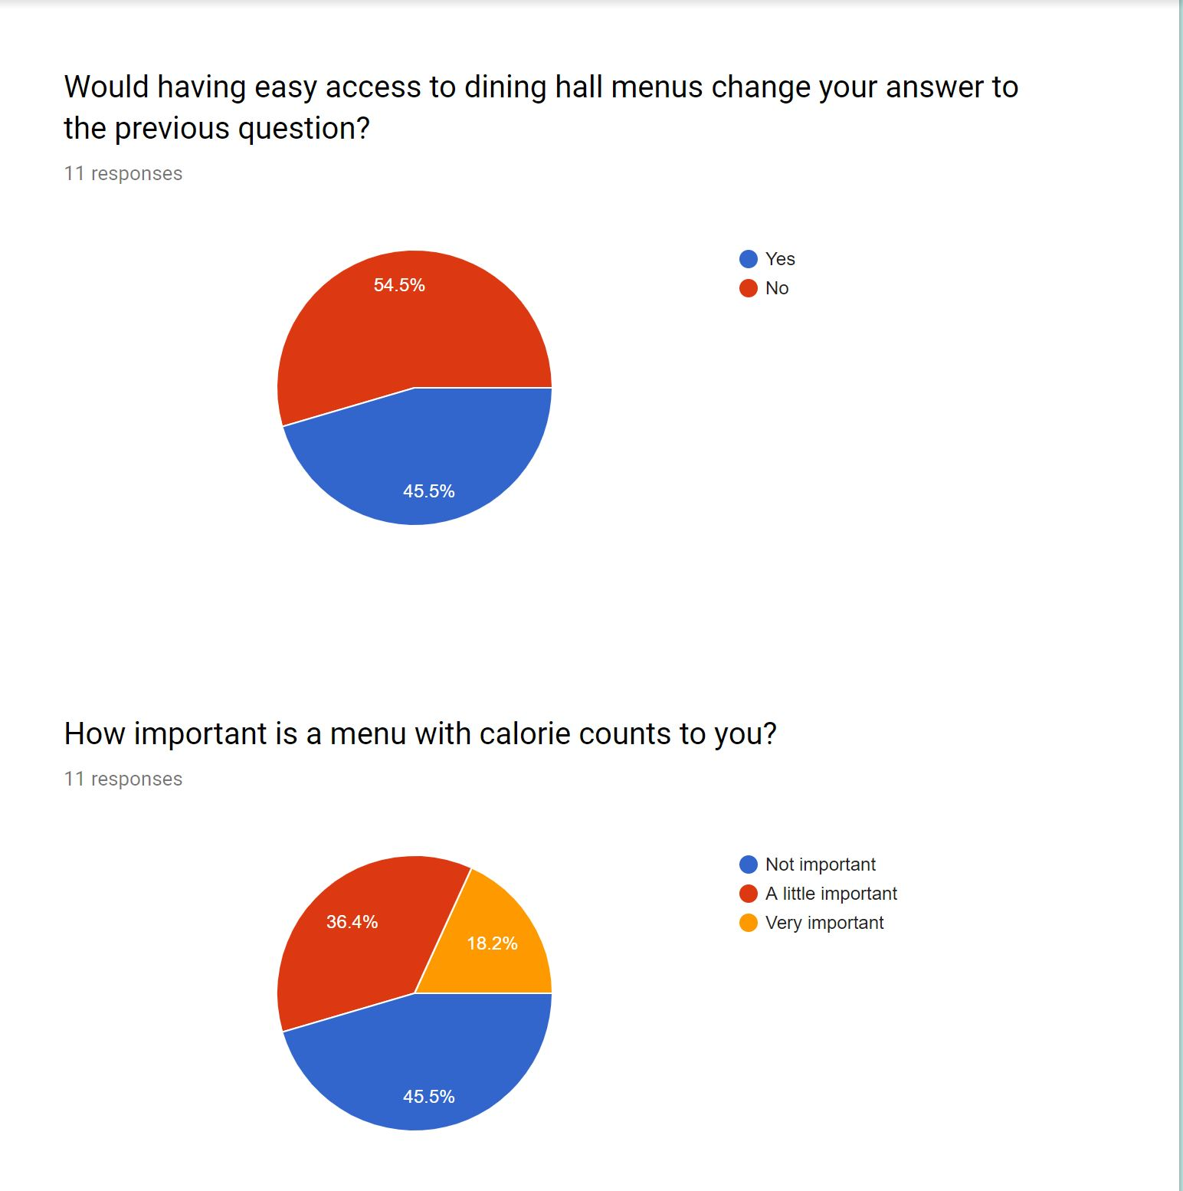
Analysis of Answers

Slide 6
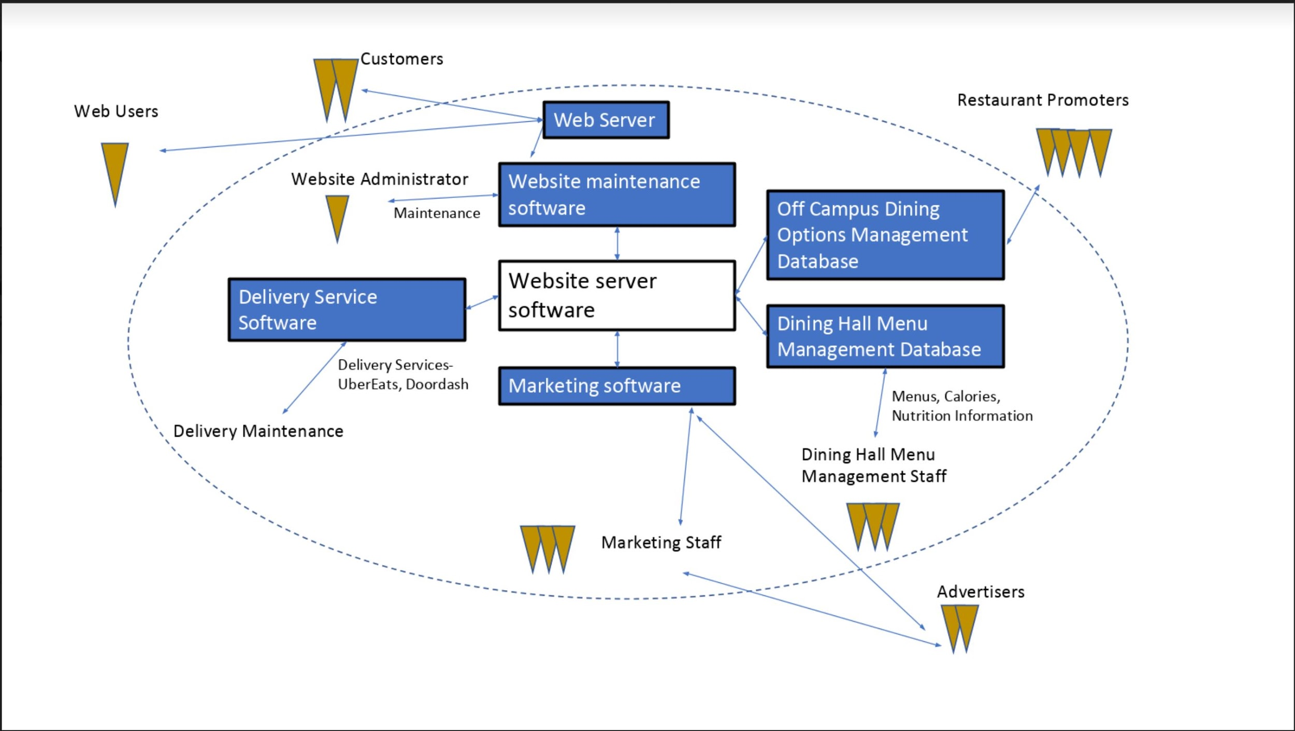
First Vision - Work Flow Model

Slide 7
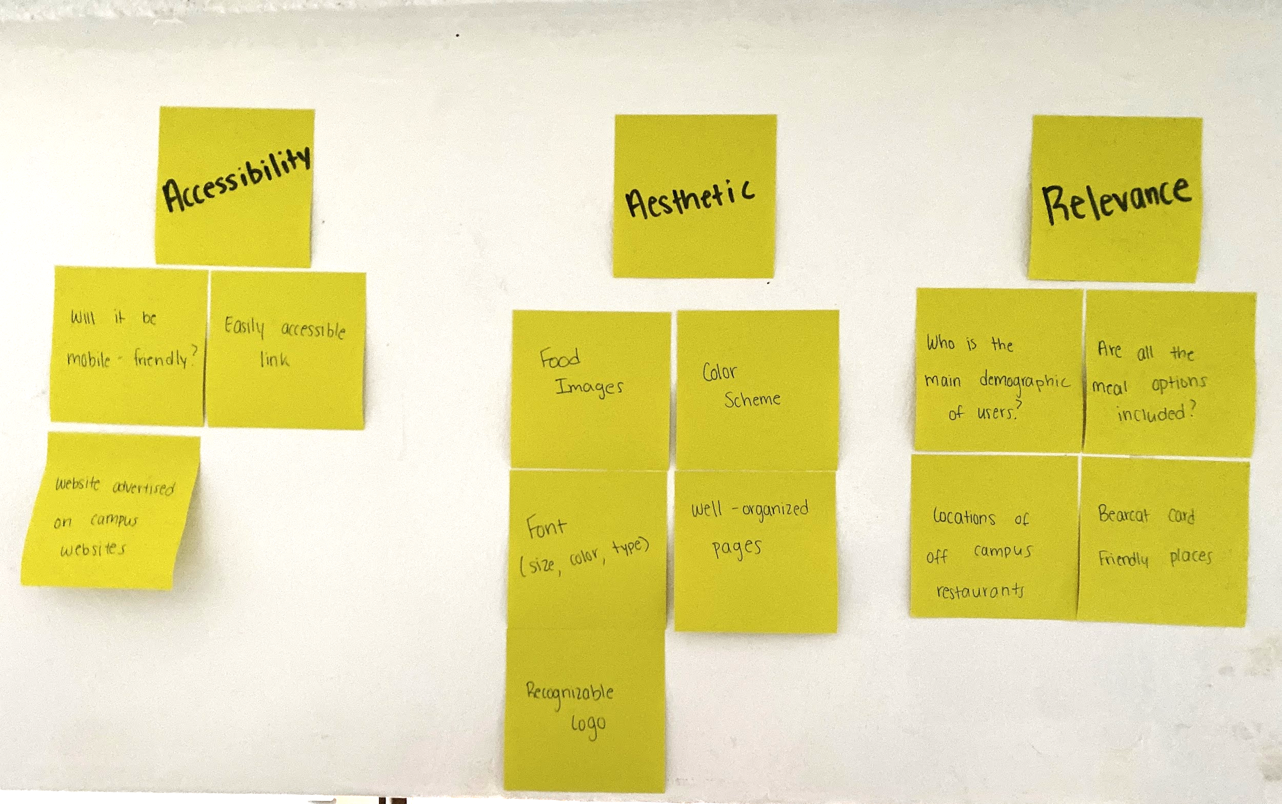
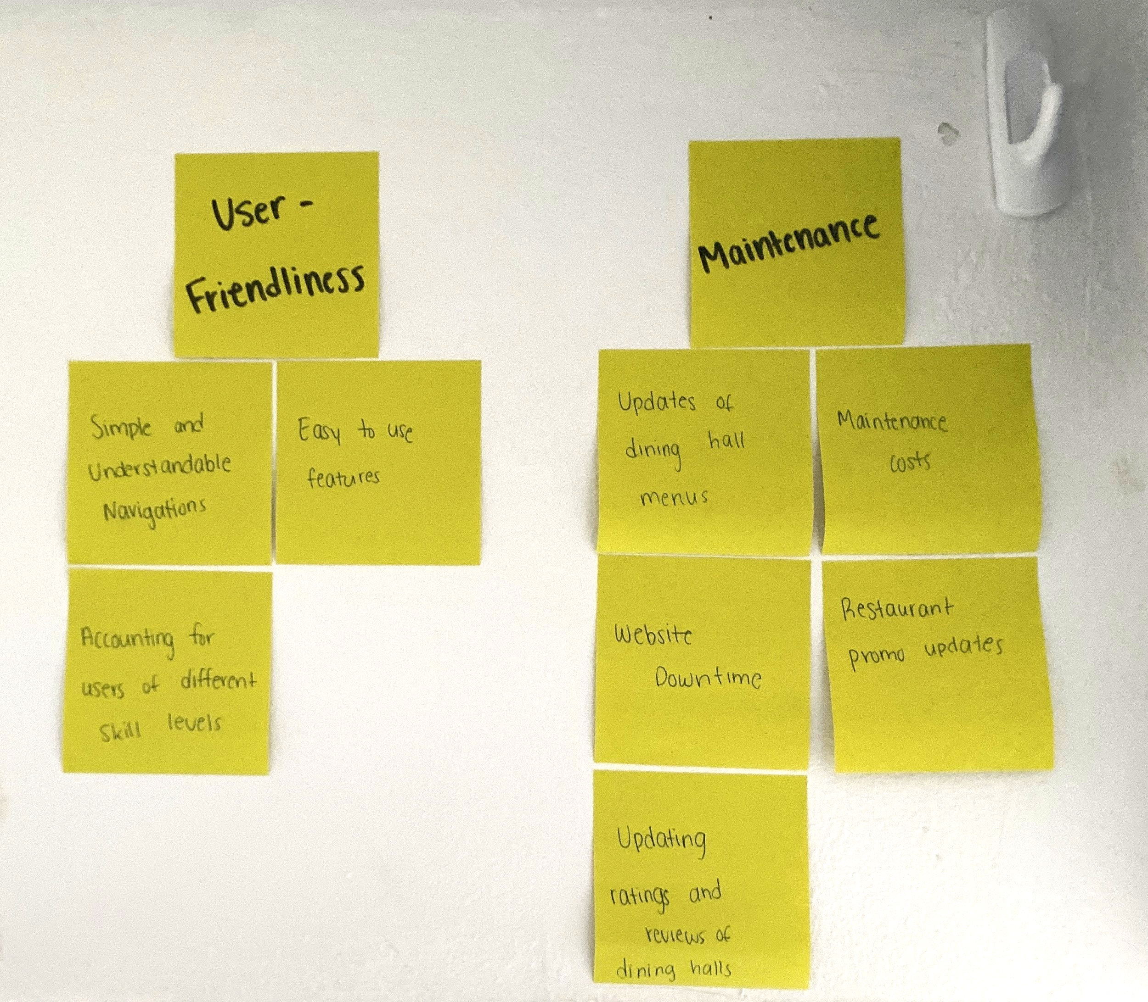
Work Affinity Diagram

Slide 8
System Concept
HealthDash is going to be mostly for college students and staff on campus. Users will be able to view dining hall options or choose off campus options all through one platform. They will be able to access the menus for the different places on and off campus along with a description of the calorie intake and other nutritional benefits. If a person checks the website and wants to eat something off campus, UberEats and DoorDash will be available to order from. It will be useful as everyone eats and this will help them make the best choice since they will be able to view all of their options. Furthermore, while the website will be targeted towards UC Students, it will be open to anyone that lives close to campus. This website will be user friendly and accessible that way all people can use it to suit their needs.

Slide 9
UX Design Lifecycle Stage 2: Design
We created multiple design personas to help us improve our design to suit the needs of many
An ecological sketch was created to show the set up of how the software would be used to create the website
The interactive sketch shows a user navigating to a specific option
We made an emotional sketch to highlight a user’s emotions when using HealthDash
Our storyboard shows the different steps as a user uses HealthDash

Slide 10
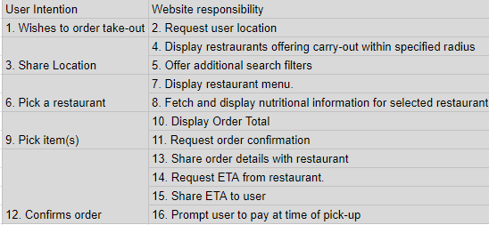
Essential Use Case Task Interaction Model

Slide 11
Design Persona
Persona Statement:
As Rachel gets done with class, she realizes that she doesn’t have a ton of time before her next class to get lunch. While spending the weekend visiting her friend at another college, she went out to eat a lot and didn’t always go to the healthiest places. She pulls out her phone and gets on the HealthDash website. She opens the menu for her favorite dining hall and sees that the dishes for today all contain tomatoes. She is glad to have known that before she made her way all the way across campus. She checks the website again and sees that MarketPointe has the best options for her today and can easily find the healthiest option available there as well. She views the nutritional information and decides to go to the sandwich bar. So as soon as Rachel gets to the dining hall she knows exactly which station to go to and is able to make it back to class on time. After her next couple classes Rachel is exhausted and just wants to go back to her room, but she is also very hungry. Luckily, she gets on HealthDash and finds a convenient delivery option that accepts the money on her Bearcat Card. This saves her from worrying about going to get food or spending any extra money.
Design Persona:
Rachel Smith is a first-year college student at the University of Cincinnati. She loves talking to others and hearing their opinions on things. In the past she was used to eating home cooked meals and packing her own lunch. This allowed her to know where each meal was coming from and make sure that she had well balanced meals. Rachel tries to eat healthy but loves to go out to eat occasionally. She is a Bearcat card holder and has $150 to spend for the semester. Not wanting to spend much more than that she tries to find the cheapest places with the best deals to go to when eating off campus. Rachel is allergic to tomatoes, so she likes to know what food is going to be at the dining halls each day. This way she can go directly to the one that has food which she can eat.

Slide 12
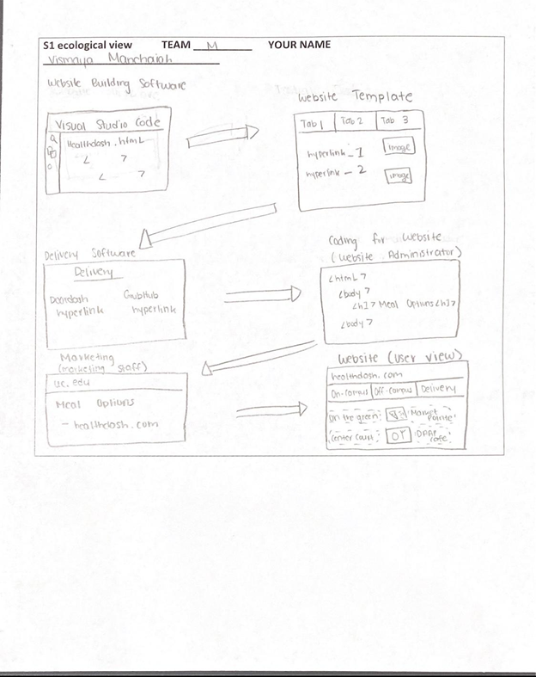
Ecological Sketch

Slide 13
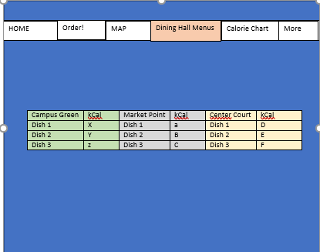
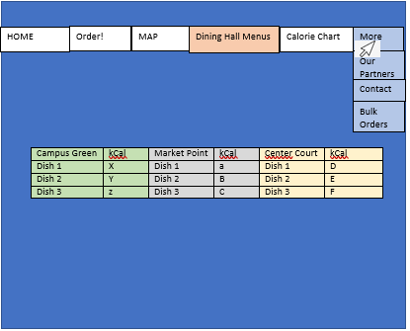
Interactive Sketch

Slide 14
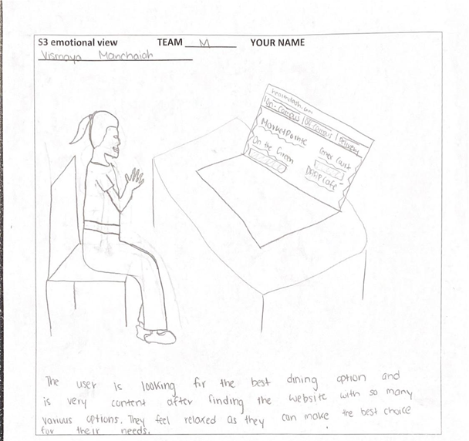
Emotional Sketch

Slide 15
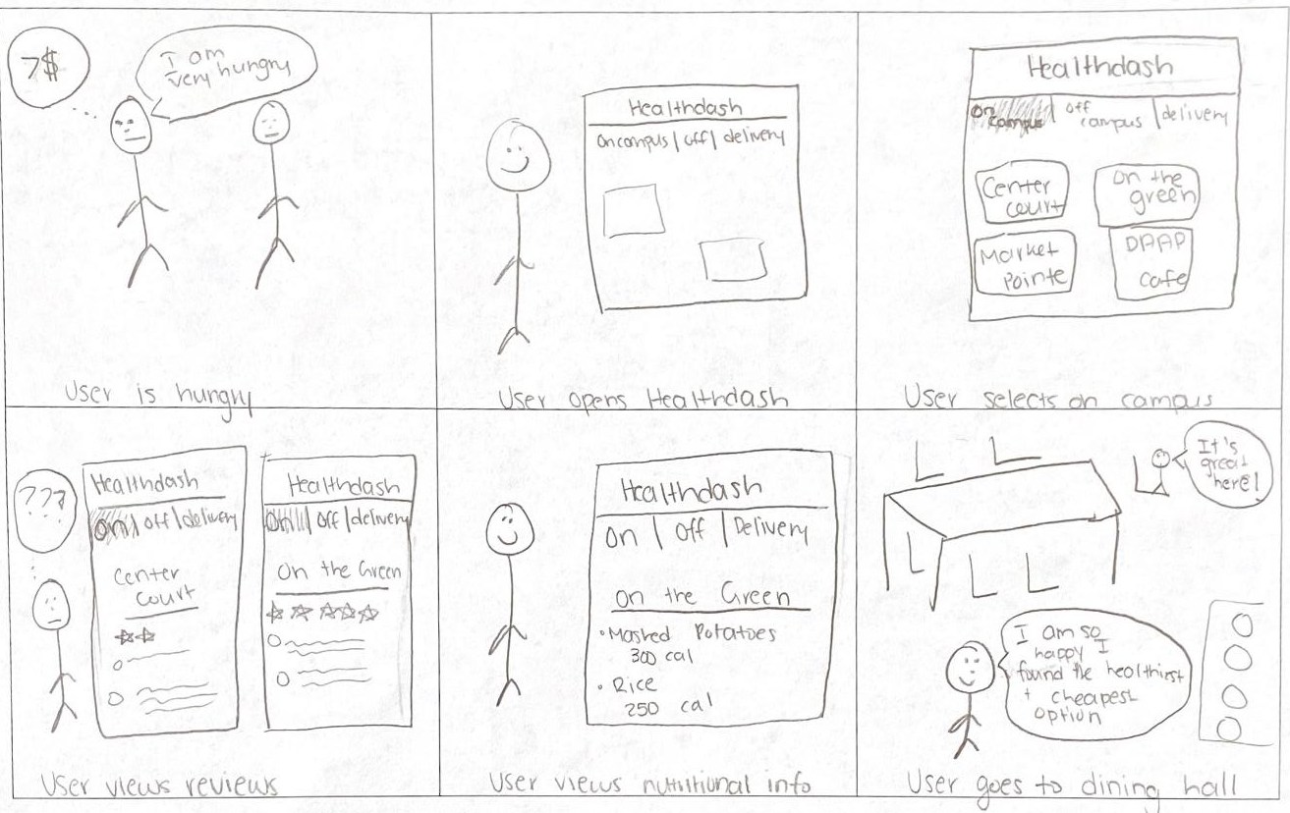
Storyboard

Slide 16
UX Design Lifecycle Stage 3: Prototype
A HTI diagram was created for the two main tasks
We used wireframes to map out how a user will navigate through our website
Basic html experience was used to create a functioning website

Slide 17
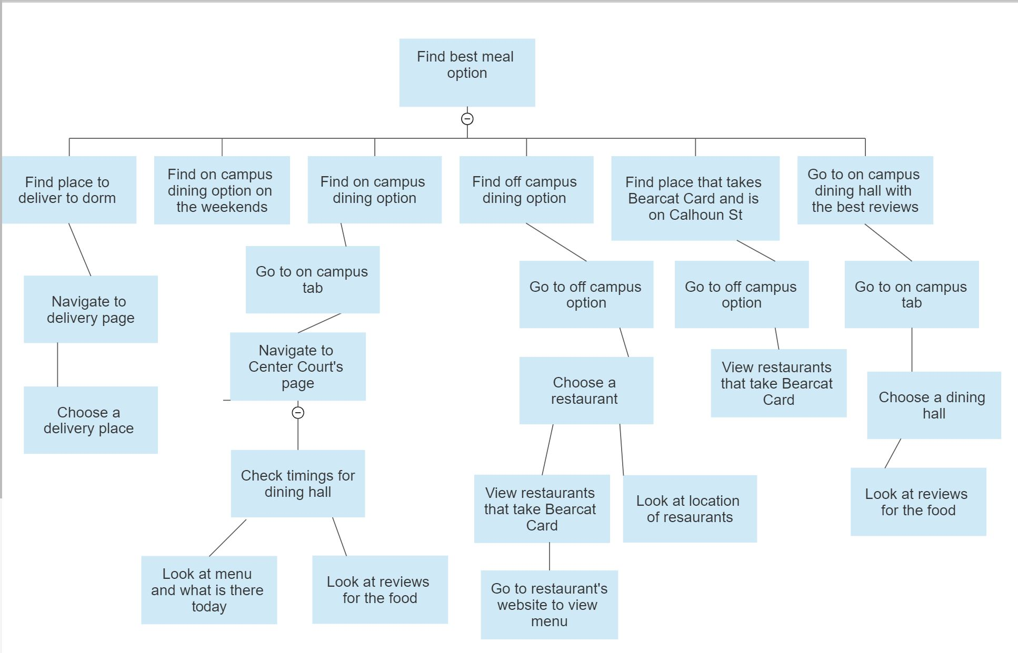
Hierarchical Task Inventory Diagram

Slide 18
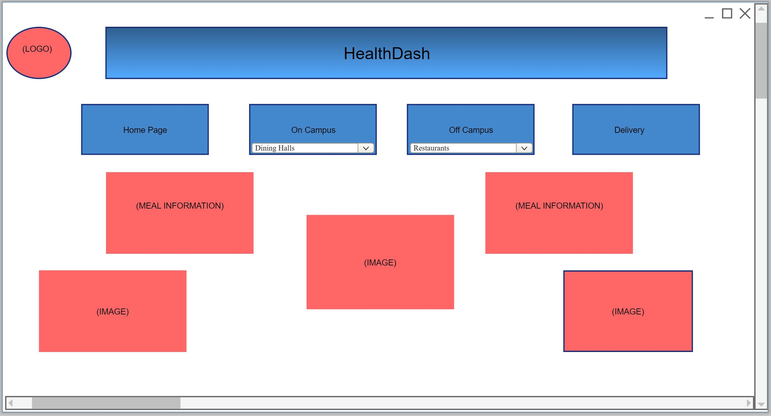
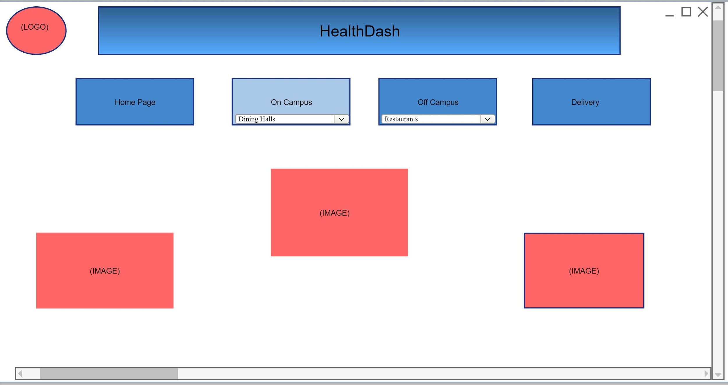
Wireframes for a Task
The user begins by navigating to the homepage of the website.
2) The user then selects the on campus tab in the navigation bar at the top of the page.

Slide 19
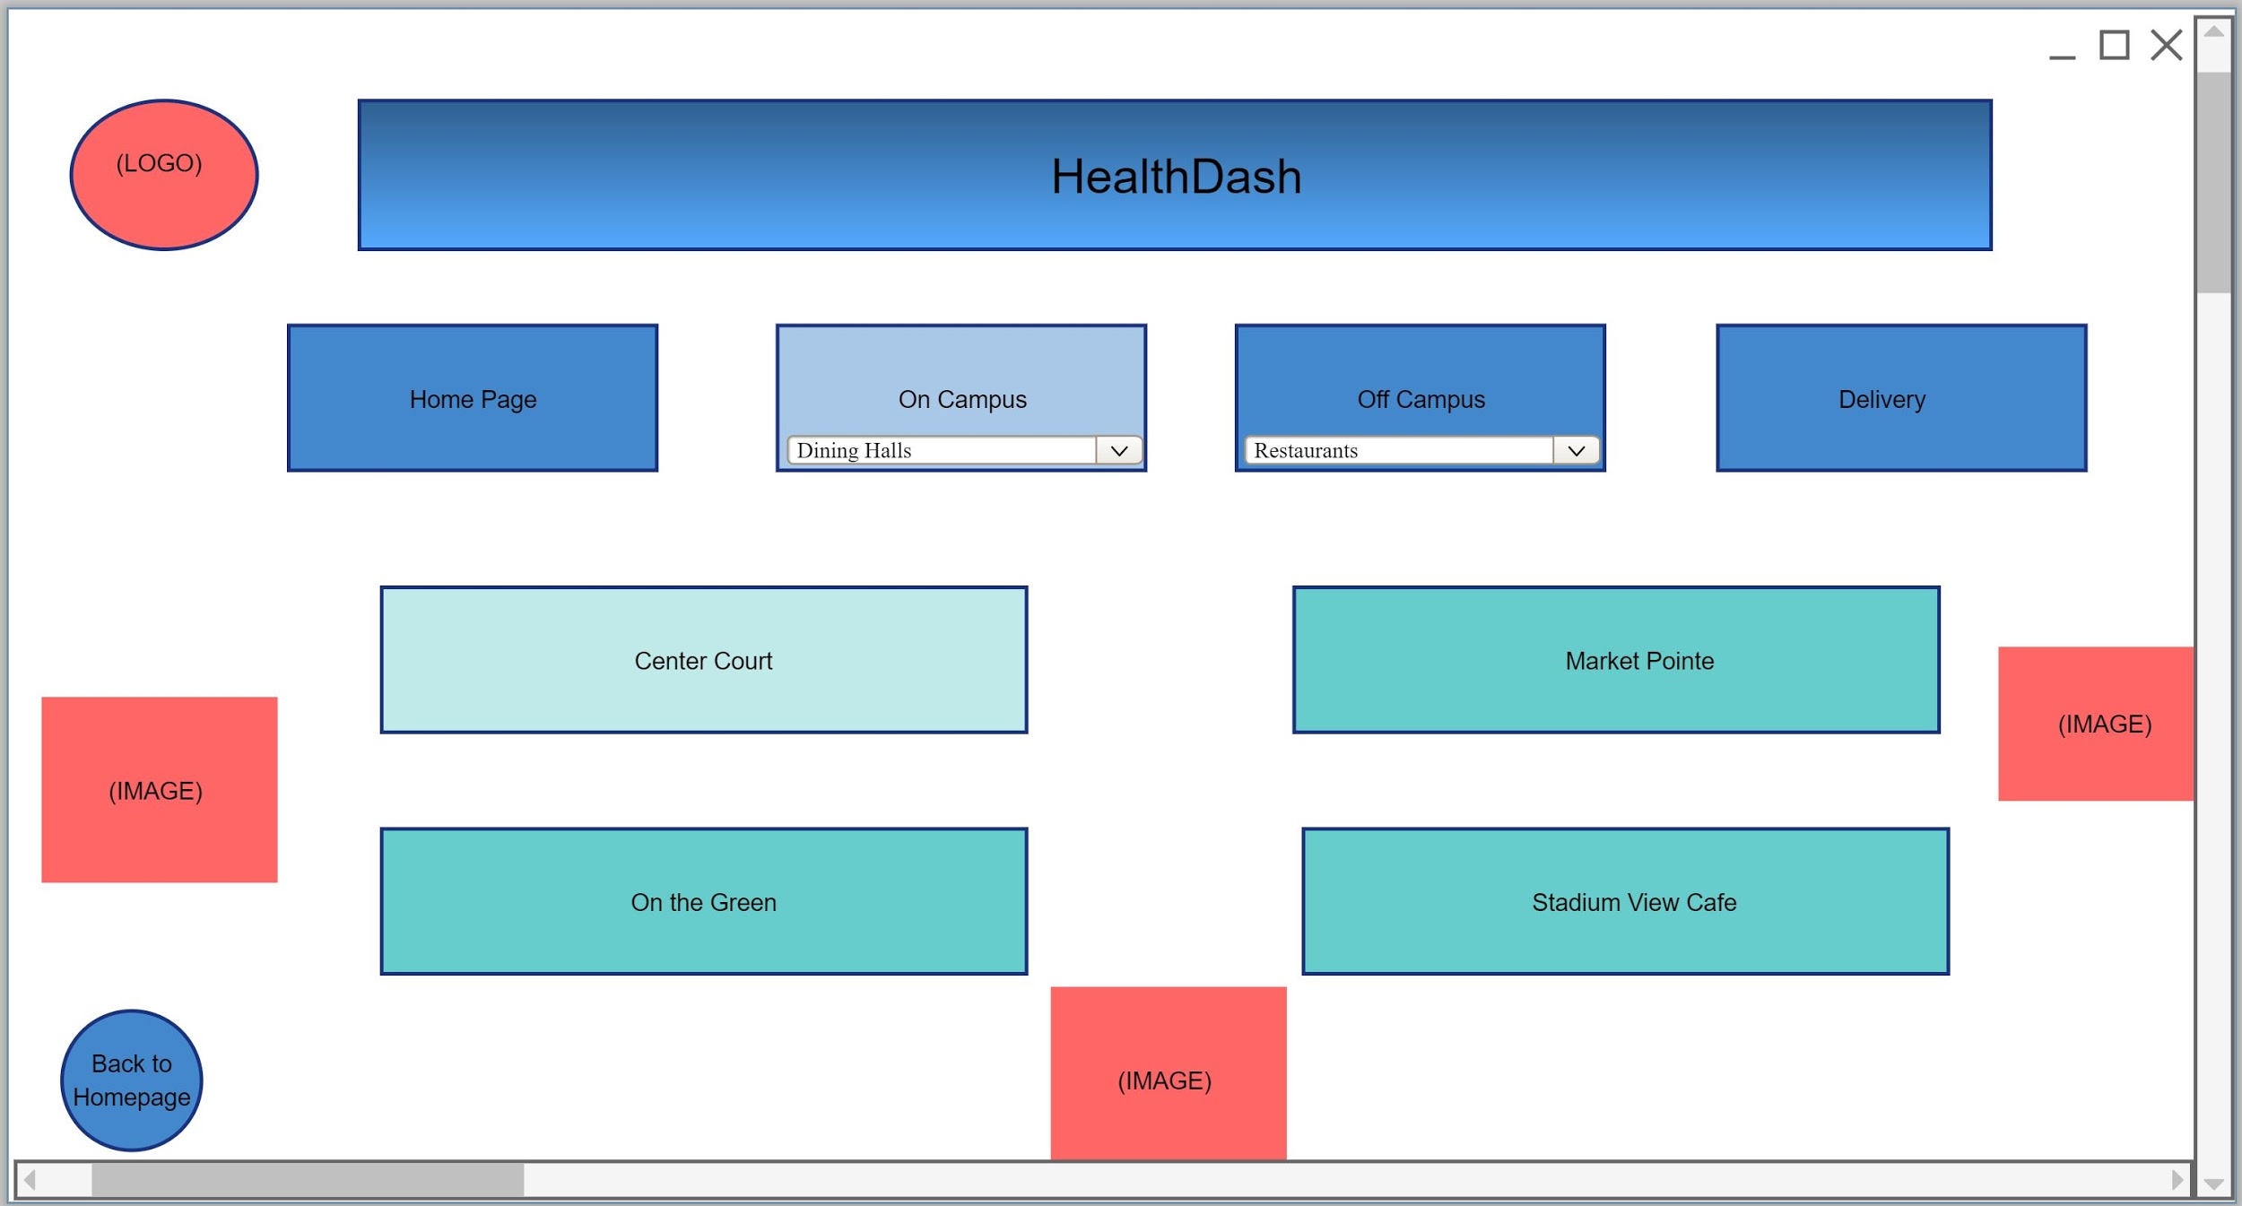
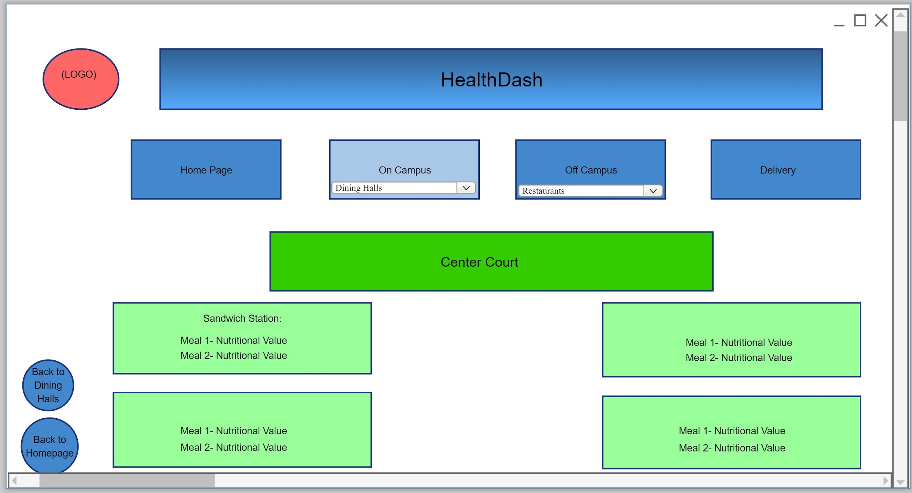
3) The user chooses one of the dining hall tabs that is located on the on campus page.
4) The user can view the menu and nutritional information of the meals at the specific on campus dining hall chosen.

Slide 20
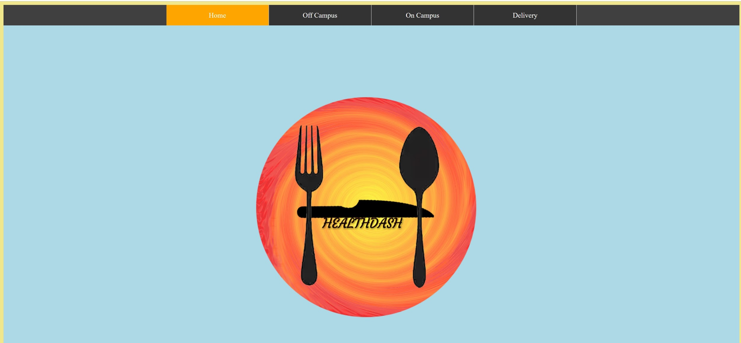
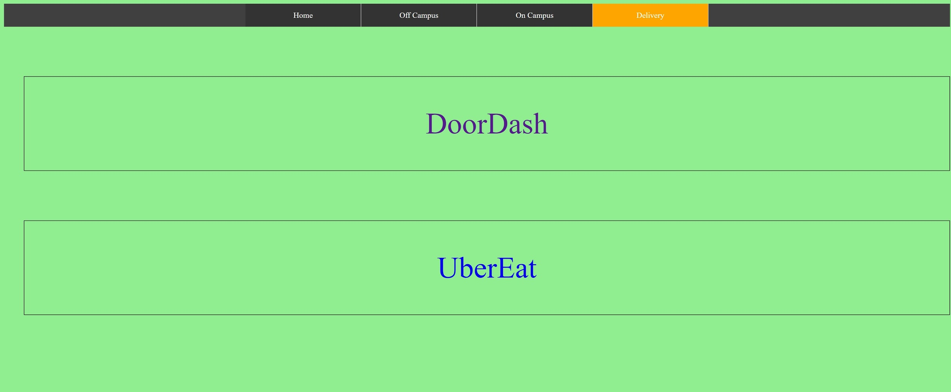
Basic Website

Slide 21
UX Design Lifecycle Stage 4: Evaluate
We had users complete tasks and recorded data from each task run
Users completed surveys once completing task about our design
We analyzed data from user completing task and surveys
Had users comment on the website design to get more feedback
Made final improvements to design based off of evaluations

Slide 22
Qualitative Data from User Tasks
User 1:
Emotional response when task 1 is assigned?
User seemed eager to get started
Emotional response while conducting task?
Seemed focused while completing task;
Frustrated when there was incorrect navigation
Emotional response once task is complete?
Proud of oneself after completion of task
Body language while conducting task?
Was bent over on computer
Eyes were squinted focused on the screen
User 3:
Emotional response when task 1 is assigned?
Excited to begin task
Emotional response while conducting task?
User was focused and relaxed while conducting the task
Talked to themself while working on the task
Emotional response once task is complete?
Was content once task was completed
Body language while conducting task?
Relaxed during majority of task
Was more concentrated after incorrect navigation
Emotional response when task 2 is assigned?
Eager to complete second task
Worried about navigating other parts of the website

Slide 23
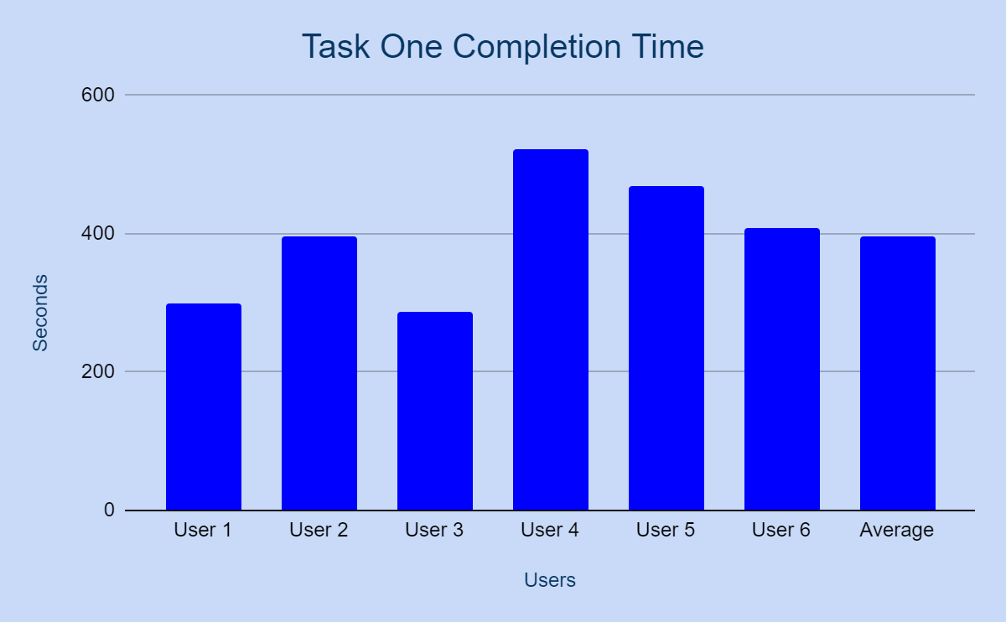
Quantitative Data
Quantitative Data
User 1:
Time to complete task 1?
300 seconds
Number of incorrect navigations?
2
Number of questions asked during task?
2
User 2:
Time to complete task 1?
395 seconds
Number of incorrect navigations?
4
Number of questions asked during task?
1

Slide 24
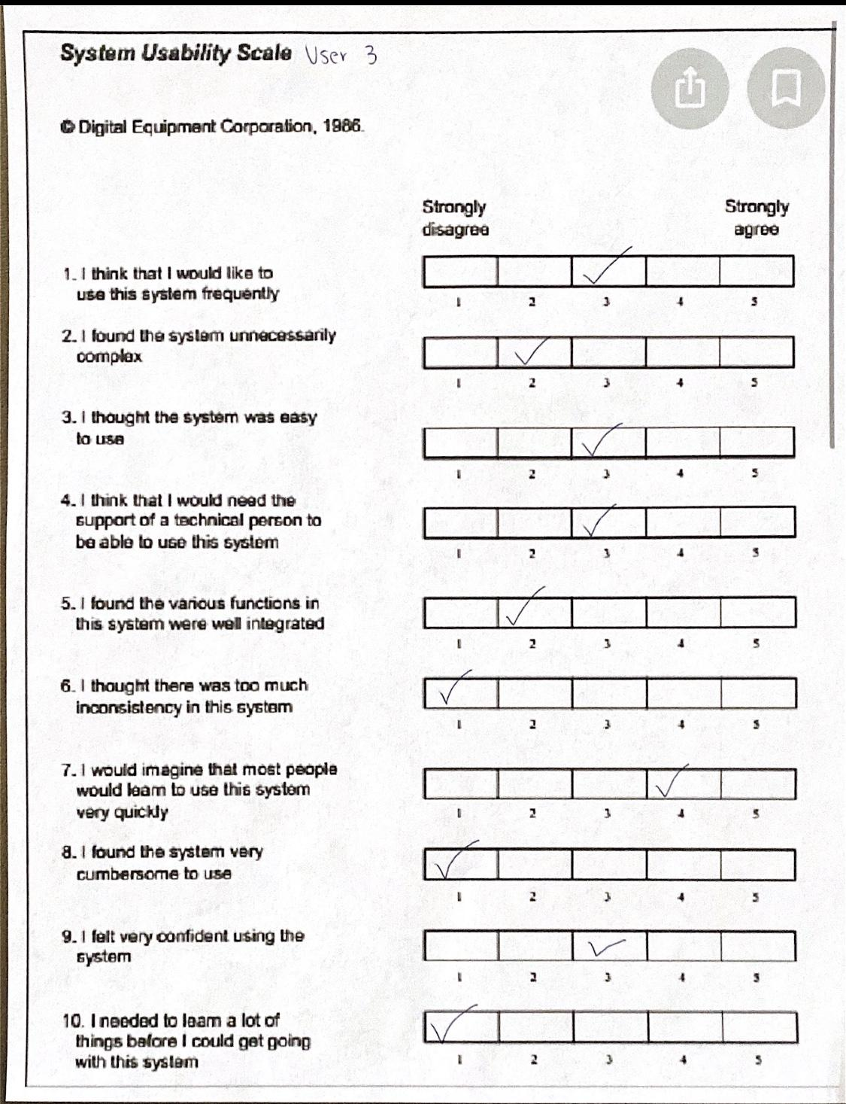
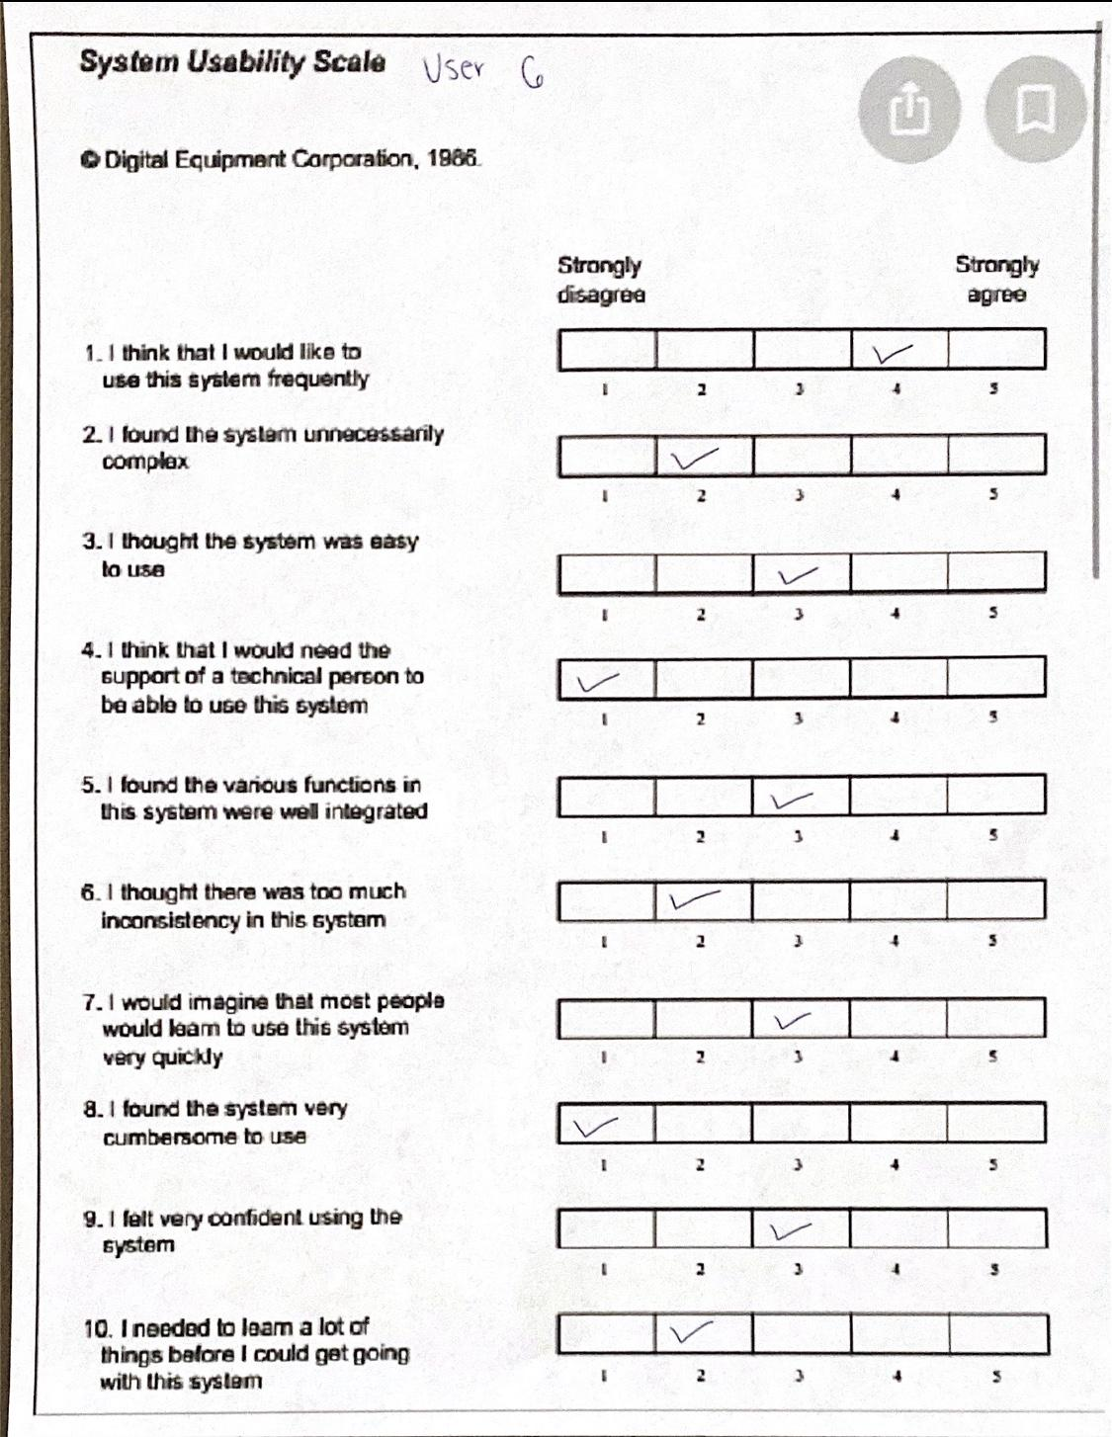
System Usability Scale

Slide 25
User Comments on Design
User 1-
I really liked the website and think it is something that I would use frequently. It would depend on how convenient it would be to access.
User 2-
Website was set up well; Liked different headings at the top; Would use often
User 3-
The website was really cool! I thought that this is something that I would definitely consider using if it were implemented. I liked all the cool functions on it! It was well set up, but I don't know if all the features would apply to me.
User 4-
I don’t know if I would use this website, but I think others would benefit from it. It works well for what is needed.

Slide 26
User Experience
Going through the lifecycle really helped apply the skills we learned in class to something that we could see the results from. Creating an actual product and having users test it really showed how an actual UX designer goes through the process of creating a design. We learned what each of the different steps entailed, such as finding out what users need in the product and the best way to create the design while accounting for what the users want.

Slide 27
Lessons Learned
After getting first feedback from a client things that we had not considered were brought up
The design will continue to change until the final evaluation because of all the feedback received
The design models will help outline a lot of different perspectives of the design
Moving from stage to stage our outlook on the project was enhanced
When it comes to the actual assembly of the prototype there will be some things that are hard to implement as imagined

Slide 28
Lifecycle of the Project
With each of the lifecycle many things changed in our design. During the first stage of the lifecycle we just had the basis of what we wanted our website to look like. After interviewing potential users and talking to our client we were able to form a more solid outline of what our design would be adding more types of dining options. In the next stage as we constructed design informing models and sketches we really got a better understanding on what exactly the goals of our design is and how we can expand features such as location and hours to make it appealing to use. Continuing on, in our prototype stage as we created the wireframes and started building the actual website we came across a lot of new things we had to consider. Things such as how implementing the off campus information would be trickier than we thought and it would be harder to implement some sorting features for restaurants. We started to see what we could use from our design ideas and what would need to be changed. In our final stage after having six users evaluate our project we worked with the feedback received. We made our final changes to HealthDash, making it more appealing to users and adding a place for users to easily navigate backwards to the previous tab.

